Slide 1

Motion Control：Lecture 5.1
The interpolation of Point to Point
Jiangang Li
14 Nov 2016

Slide 2
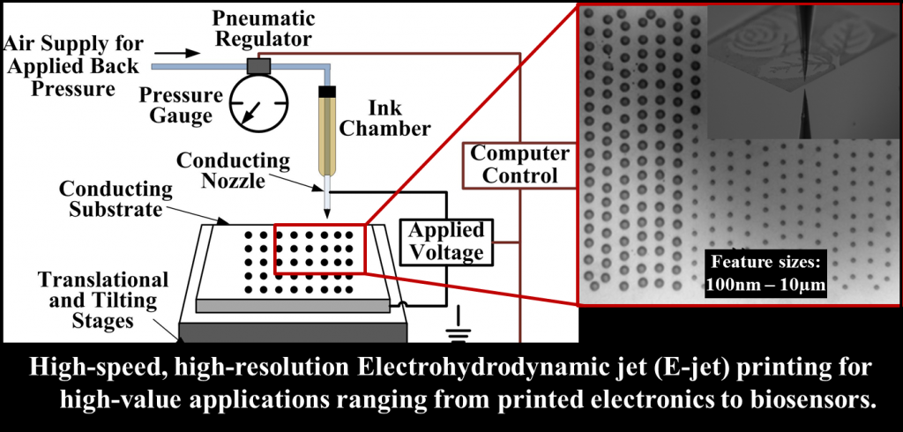
1、 Introduction
Fig1 A structure of E-Jet

Slide 3





1、 Introduction
Point to point motion is one line tool path with zero start and end velocity. This motion is applied in many machines like semiconductor equipment, medical device etc.
Fig.2 Point to point (PTP) move

Slide 4
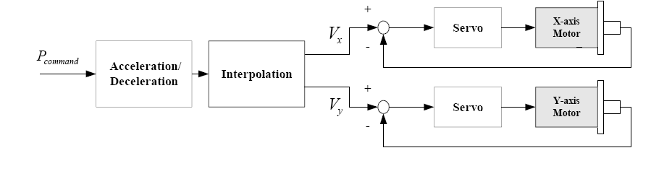
1、 Introduction
Through short multi-section velocity plan and interpolation. The multi-axis reference point will be given to control loop.
Fig.3 Control loop of CNC

Slide 5

1、 Introduction
Three-loop architecture: position, velocity and current loop
PID for every loop with parameters tuned in manual
Velocity+ Acceleration feedforward
Velocity+ Acceleration Feedforward Controller
Bias Compensation
PID Position Controller
PWM
Reference Point
X(t)
PI Velocity Controller
PI Current Controller
Motor
Position Feedback
Velocity Feedback
Current Feedback
Fig.4 Classic block diagram of servo controller

Slide 6
1、 Introduction
Y
No Interpolation
Start Point
Mid Point
End Point
O
X
Fig.5 Interpolator

Slide 7
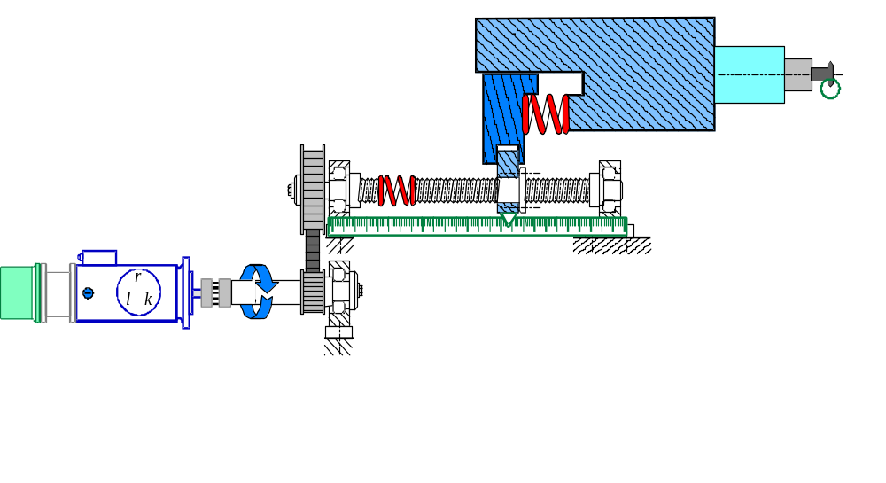
2、 Velocity Planning
Typical Machine Design
In-the-loop flexibility
Position
to be
controlled
Motor Encoder
Indirect sensor
Linear scale
Direct Sensor
Out-of-the-loop
flexibility
V_{MOTOR}
X_{AXIS}
An in-the-loop compliance affects the stability.
An out-of-the-loop compliance affects the precision.

Slide 8







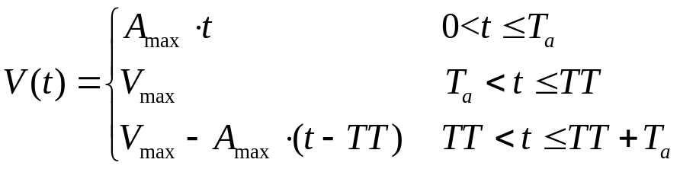

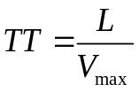
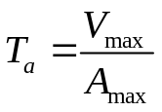
2、 Velocity Planning
According to machine tool dynamic characteristic, the maximum velocity and acceleration are given.
In trapezoidal profile velocity plan, a line change in velocity cause a acceleration step, the derivative of acceleration (Jerk) is a impulse. Impulse jerk cause machine oscillations.
Formula of Velocity plan:
Where,
Fig.8 Trapezoidal profile velocity plan

Slide 9
2、 Velocity Planning
Jerk-controlled position
X_{CNC}
V_{CNC}
J_{CNC}
γ_{CNC}

Slide 10

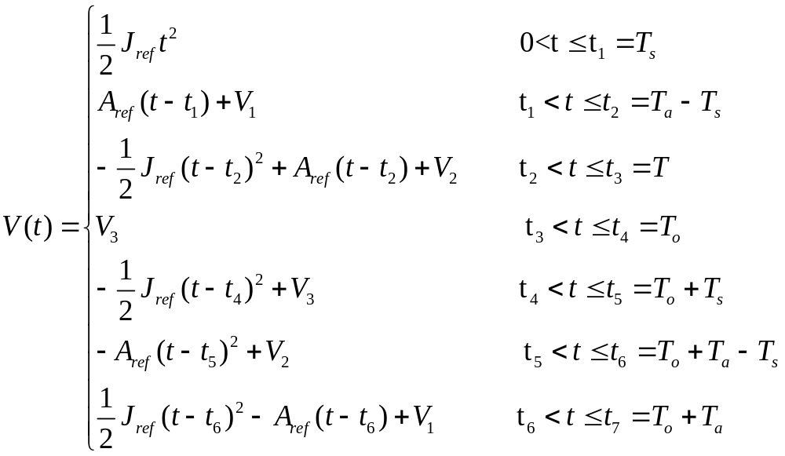




2、 Velocity Planning
In S profile velocity plan, Jerk is a step and limited to desired value. To prevent machine oscillations, the jerk is limited to attain optimum path control. Hard to make continuous tool path velocity planning.
Formula of Velocity plan:
(2-2)

Slide 11
2、 Velocity Planning
Trapezoidal jerk pattern
X_{CNC}
V_{CNC}
J_{CNC}
Q_{CNC}
γ_{CNC}
Notes:
16 échelons de dérivée de jerk
4 intégrations pour passer de la dérivée du jerk à la position
Intérêt d ’une machine rigide et amortie

Slide 12
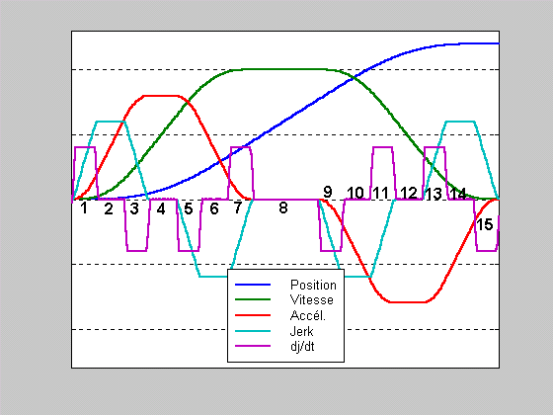
S type of jerk profile
2、 Velocity Planning
Bell-shaped acceleration pattern
Notes:
On n ’a pas toujours le temps de voir toutes les phases.

Slide 13
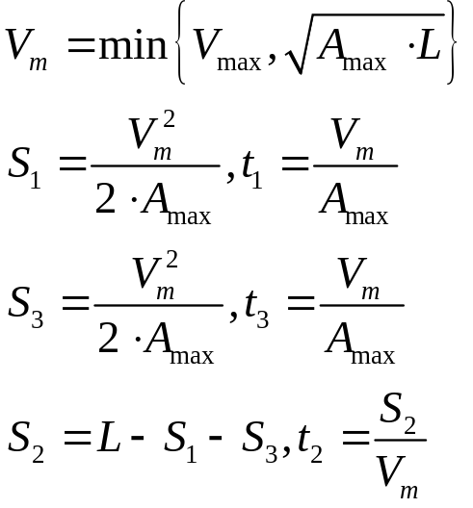







3、 Interpolation
Single line feedrate planning and interpolation
For interpolation, the time consumed must be integer times of interpolation cycle.
(a)
(b)
Fig.11 Trapezoidal profile velocity plan of one section

Slide 14
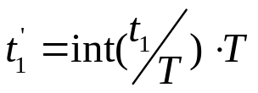

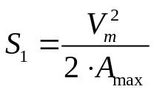
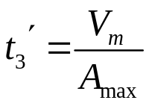
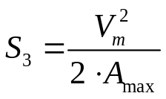
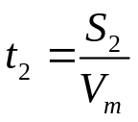





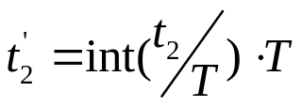


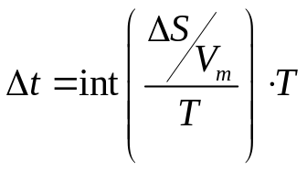


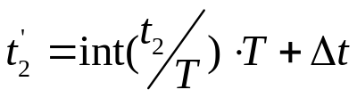
3、 Interpolation
(a)
(b)
Fig.12 Interpolation of one section
The acceleration time, uniform feedrate time, deceleration time are the integer times of the interpolation cycle. This error is small enough to assure the machining accuracy, it is dependent on the interpolation cycle.

Slide 15



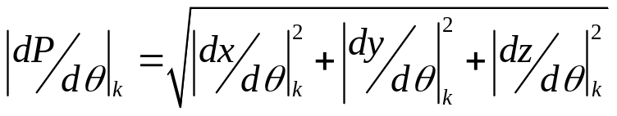



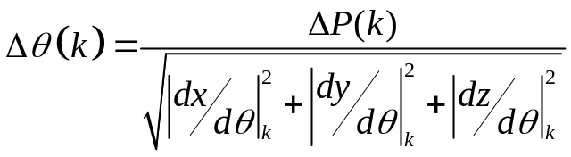
3、 Interpolation
Proposed single arc feedrate planning and interpolation
(a)
(d)
(b)
(c)
Fig 13 Each step of arc interpolation
Fig.(a) shows the changing profile of .
Fig.(b) shows that corresponding to .
Fig.(c) depicts the changing the profile, with the Acc/Dec characteristic.
Fig.(d) shows that with the Acc/Dec characteristic.

Slide 16
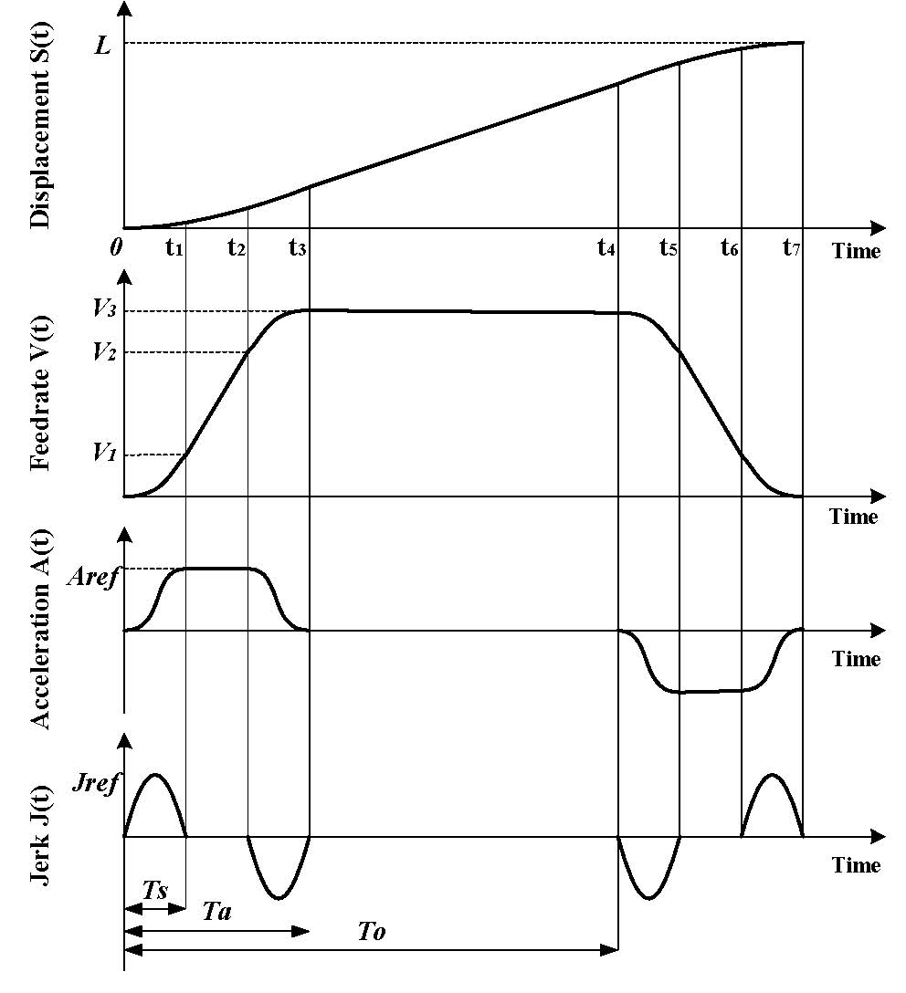

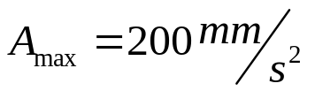


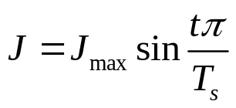
4 Question and homework
Where,
Point
Q1: Point to Point Formula of S velocity plan?
The fig4.1 is a Squared sine velocity plan.
Q2: Point to Point Formula of squared sine velocity plan?
Fig.10 Squared sine velocity plan

